Slide 1
Transfer Learning in NLP
Advance NLP

Slide 2
Embeddings
Intro to Transfer Learning
Transformer Based Model
Deep Averaging Network
Universal Sentence Encoder
Hands On

Slide 3




Embeddings
An embedding is a mapping from discrete objects, such as words, to vectors of real numbers. For example a 200 dimensional embedding for English words can be:
blue: (0.01359, 0.00075997, 0.24608, ..., -0.2524, 1.0048, 0.06259) blues: (0.01396, 0.11887, -0.48963, ..., 0.033483, -0.10007, 0.1158) orange: (-0.24776, -0.12359, 0.20986, ..., 0.079717, 0.23865, -0.014213) oranges: (-0.35609, 0.21854, 0.080944, ..., -0.35413, 0.38511, -0.070976)

Slide 4
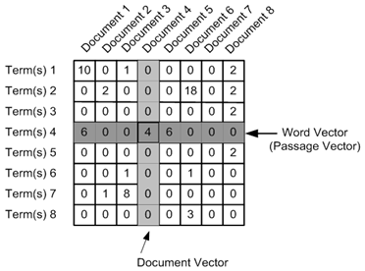
Word Vector
Looking at the co occurance of words in a text span, we can create a co occurance matrix.
From this matrix we can obtain the word vector.

Slide 5
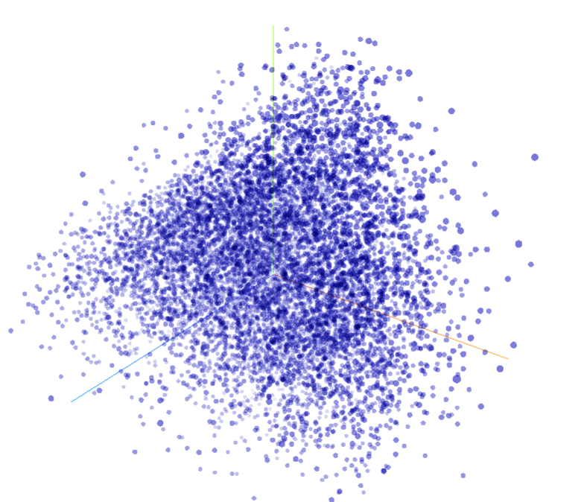
Word Embedding Vector
The word vector can represent a word by a vector of numbers whose length is equal to the number of documents.
You can project this matrix to a smaller space using dimensional reduction technique.
You can visualize the embedding space of 10k words in this playground.
http://projector.tensorflow.org/

Slide 6
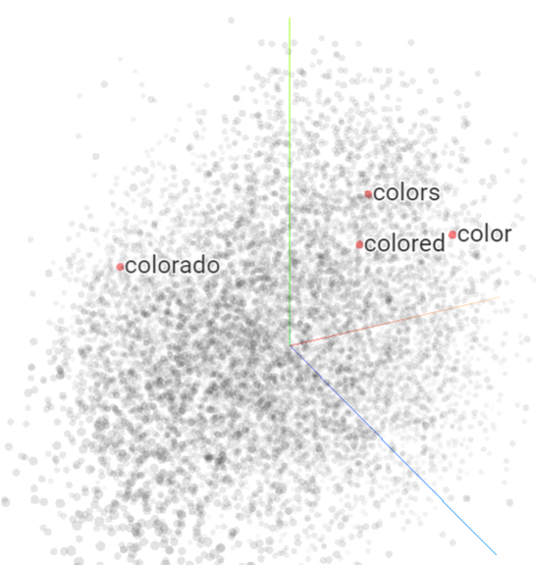
Similar words
Using this word embedding vector, you can find that semantically similar words are located closely in the embedding space.
Colors, color, colored are located closely.
Colorado is far away in the embedding space.
You can try this out here http://projector.tensorflow.org/

Slide 7
Embeddings
Intro to Transfer Learning
Transformer Based Model
Deep Averaging Network
Universal Sentence Encoder
Hands On

Slide 8

What is Transfer Learning?
In general terms, transfer learning means if a model is trained on a specific task, we can use it for a slightly different task.

Slide 9
Different NLP Tasks
These are the standard NLP tasks:
Text classification
Named Entity Recognition
Sentiment Analysis
Topic Modelling
Text Similarity
Text Summarization
Text Generation
Question and Answer Systems

Slide 10
Reasons to use Transfer Learning
Current limitations of different NLP problems-
Limited training data available for each tasks
High cost of annotating supervised training data
Training dataset is not available
High cost for training models
The same problems occur for languages other than English.

Slide 11
Pre-trained models come to the rescue
Classical NLP problems requires you to train simple models using GPU.
But for more accurate predictions you will need to train multiple GPUs for months.
Once this is done, the models are released so that others can use it.
Here are some of the popular pre-trained NLP models:
Pretrained word2vec
Universal Sentence Encoder
ELMo
GPT-2
BERT

Slide 12
Embeddings
Intro to Transfer Learning
Transformer Based Model
Deep Averaging Network
Universal Sentence Encoder
Hands On

Slide 13

Universal Sentence Encoder
Universal Sentence Encoder is a paper released in April 2018 by Google Research which discusses encoding sentences into embedding vectors that specifically target transfer learning to other tasks.
The Universal Sentence Encoder encodes text into high dimensional vectors that can be used for text classification, semantic similarity, clustering and other natural language tasks.

Slide 14
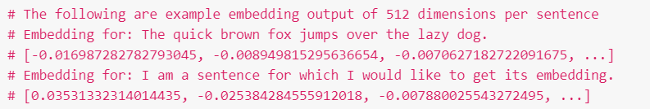
Ideas behind Sentence Embedding
With transfer learning via sentence embedding it was observed that this model outperforms word level embedding for many NLP tasks.
Sentence embedding can be used to obtain surprisingly good task performance with minimal amount of supervised training data for transfer tasks.
Notes:
**Show NLTK Stopwords

Slide 15
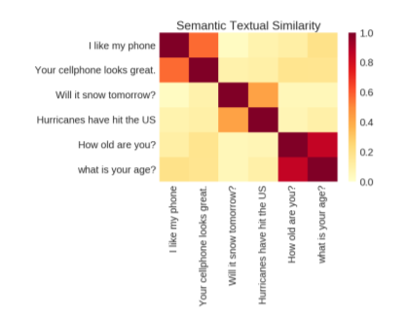
Sentence Similarity
Once we obtain sentence level embedding, we can easily identify how two sentences are similar.
Notes:
**Show NLTK Stopwords

Slide 16
Variants of Universal Sentence Encoder
Google released two variants of Universal Sentence Encoder:
Transformer
Deep Averaging Network(DAN)
Transformed based model produces high accuracy in many NLP tasks.
But this involves huge model complexity and resource consumption.
DAN is a smaller model which produces slightly less accuracy.
This requires less computation and resources.

Slide 17
Embeddings
Intro to Transfer Learning
Transformer Based Model
Deep Averaging Network
Universal Sentence Encoder
Hands On

Slide 18
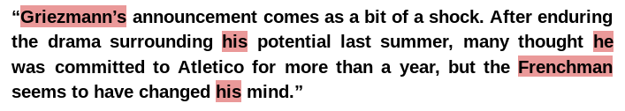
Transformer Model
Transformer is the most advanced concept which has led to development of state of the art NLP models such as Universal Sentence Encoder, ULMFiT and BERT.
The model is able to understand that he, his, Frenchman and Griezmann’s all refer to a person Griezmann, a popular football player.

Slide 19
Transformer word embedding
It generates context aware representations of words in a sentence that takes into account both ordering and identify of all other words.
The word embedding will be a vector of length 512.
We will study the detailed working of transformer model in the next module.

Slide 20
Creating Sentence Embedding
Once we have generated word level embedding, we will need to create sentence level embedding.
512 vector length
Word Embedding
N words
Sentence Embedding = $\frac{Sum of all word embedding}{√N}$
This ensures that long sentences do not dominate over short sentences.
Notes:
** Better images

Slide 21
Embeddings
Intro to Transfer Learning
Transformer Based Model
Deep Averaging Network
Universal Sentence Encoder
Hands On

Slide 22
Deep Averaging Network
Deep Averaging Networks or DAN is a new architecture where
1. Input embedding for words and bi-grams are averaged
2. This is passed through a feed forward neural network with a final layer of 512.
The word embeddings could be from a pre-trained word2vec or any other embedding model.
This will generate a sentence encoding of vector length 512

Slide 23
What is bi-gram?
In word embedding we evaluate the co occurance matric of each word.
In bi-gram, we take 2 consecutive words and evaluate their co occurance and to find bi-gram embeddings.
The sky is blue in color.
The sky
sky is
is blue
blue in
in color
Document 1
Document 2
Document 3
Document 4

Slide 24
Training the Transformer and DAN network
The transformer and DAN are encoding models as they encode sentences into vectors.
The encoder models are trained on variety of web sources such as:
Wikipedia
Web news
Web questions and answers
Discussion forum
Stanford Natural Language Inference(SNLI)
The SNLI corpusis a collection of 570k human-written English sentence pairs manually labeled for balanced classification with the labels
Entailment: If I have 4 cats is true, I have 2 cats is also true
Contradiction: If Earth is round is true, Earth is flat is false.
Neutral: It is raining now. The rain wont stop now.

Slide 25
Embeddings
Intro to Transfer Learning
Transformer Based Model
Deep Averaging Network
Universal Sentence Encoder
Hands On

Slide 26
The Experiment
Please refer to the hands on Notebook

